Slide 1
Operating Systems Tutorial
Amit Dua
Computer Science and Information Systems Department
BITS, Pilani

Slide 2
Unix File System
Tutorial 4
Slides taken from the ones prepared by Dr. Mayuri Digalwar

Slide 3
Suppose System V UNIX
Assume that a logical block on the file system holds 1K bytes and that a block number is addressable by a 32 bit integer, then a block can hold up to 256 block numbers
13 entries in the inode table of contents
10 direct, 1 indirect, 1 double indirect, 1 triple indirect block
Assume
a logical block = 1K bytes
a block number is addressable by a 32 bit (4 bytes) integer
a block can hold up to 256 block numbers
Byte Capacity of a File
10 direct blocks with 1K bytes each= 10 Kbytes
1 indirect block with 256 direct blocks= 1K*256= 256 Kbytes
1 double indirect block with 256 indirect blocks=256K*256= 64 Mbytes
1 triple indirect block with 256 double indirect blocks=64M*256=16 Gbytes

Slide 4
Processes
access data in a file by byte offset
view a file as a stream of bytes
The kernel
accesses the inode
converts the logical file block into the appropriate disk block
Algorithm bmap is used to map File byte offset to physical disk block

Slide 5
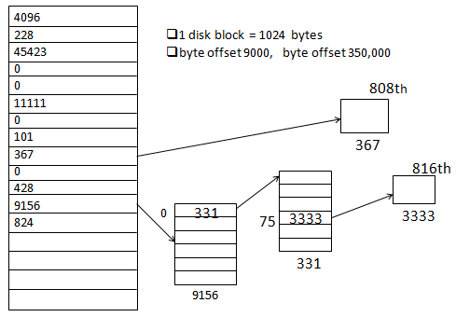
Block Layout of a Sample File and its Inode
5

Slide 6
Example
Disk block size = 1024 bytes or 1KB
4bytes are required to store one block number
256 block numbers can be stored in one index block (1024/4)
If a process makes a request to access 9000 byte offset, then find out which index block contains this byte information.
9000 / 1024 = 8 , 9000 mod 1024 = 808
That means 9000 – 808 = 8192 byte offset is last offset in 8th index block
Since 808 < 1024 , therefore byte offset 9000 is surely present in 9th index block with block no. 367 and in 808th byte

Slide 7
If a process makes a request to access 350,000 byte offset, then find out which index block contains this byte information.
First 10 direct blocks can access 10240 bytes or 10K bytes.
350,000 > 10240, therefore lets look into single indirect block.
Single indirect can address 256 blocks, each block contains 1024 bytes, so 256 * 1024= 262144 bytes can be accessed = 256KB
So 10 K + 256 K = 266 K = 272,384 bytes
Still 350,000 > 272,384 , Go ahead and search in double indirect.
350,000 – 272,384 = 77,616 byte no in double indirect.
First entry in double indirect block points to first single indirect block which holds 256 block nos and hence points to 256K byte addresses i.e 262,144 byte address.
Since 77,616 < 262,144, 350,000 will be there in one of the blocks pointed to by single indirect.
It comes out to be 75th block and 816th byte entry.

Slide 8
Directories
A directory is a file
It gives hierarchical structure to the file system
Play an important role in conversion of a file name to an inode number
Its data is a sequence of entries
Contents of each entries
an inode number and the name of a file
Path name is a null terminated character string divided into components by slash (“/”)
Each component must be the name of a directory and last may not be
UNIX System V
Maximum of component name : 14 characters
Inode number entry : 2 bytes
Size of a directory entry : 16 bytes

Slide 9
Fig Directory layout for /etc
Byte Offset in Directory | Inode Number (2 bytes) | File Name
0 16 32 48 64 80 96 112 128 144 160 176 192 208 224 240 256 | 83 2 1798 1276 85 1268 1799 88 2114 1717 1851 92 84 1432 0 95 188 | .. init fsck clri motd mount mknod passwd umount checklist fsdblb config getty crash mkfs inittab

Slide 10
File System Algorithms
Lower Level File system Algorithms
namei
alloc free ialloc ifree iget iput bmap
buffer allocation algorithms
getblk brelse bread bwrite

Slide 11
Lower level File System Algorithms
Name of Algorithm | Operation
namei | Parses the path name one component at a time and returns the inode of the input path name.
iget | Allocates the in-core copy of the inode if it exist and locks it. The inode is returned with reference count 1 greater than previous.
iput | Releases the inode by decrementing the reference count. Unlocks the inode to provide access to other system calls. Stores back if in-core copy is different from disk copy.
bmap | Converts a file byte offset into a physical disk block.
ialloc | Allocates the inode for a new file from the free list of inodes
ifree | If reference count becomes 0, the inode is released and added to the free list of inodes
alloc | Allocates the disk inode
free | Releases the disk inode

Slide 12
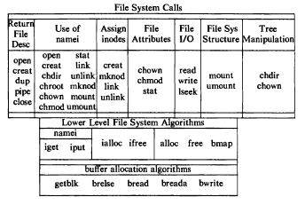
File System Calls and Relation to Algorithms

Slide 13
OPEN system call
Syntax is
fd = open(pathname,flags,modes);
int open(const char *path, int flags, mode_t mode);
int open(const char *path, int flags);
where,
pathname is the file name
flags indicate type of file (reading/writing)
modes gives the file permission (if file is created)
Returns an integer called file descriptor
Rest of the system calls make use of this file descriptor.

Slide 14
Example on open()
Mayuri@localhost myopen]$ ./exam1 t2.txt
Error opening file
[Mayuri@localhost myopen]$ ./exam1 t1.txt
file opened successfully
fd1=3
int main(int argc, char *argv[])
{
int fd1,fd2;
fd1 = open(argv[1],O_RDONLY);
if(fd1 == -1){
printf("Error opening file \n");
exit(0);
}
printf("file opened successfully\n");
printf("fd1=%d\n",fd1);
}
Fd = 0 default input
Fd = 1 default output
Fd = 2 std error
-1 fail
Success -> fd number

Slide 15
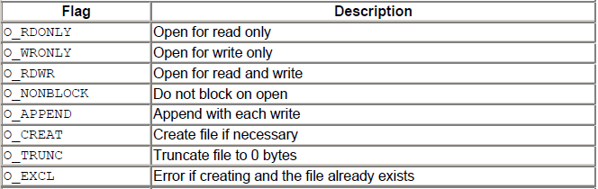
Different flags values

Slide 16
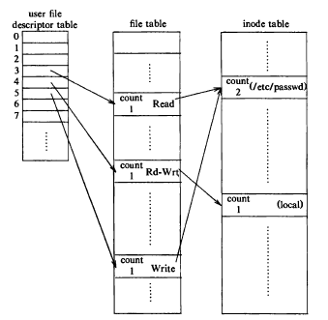


Slide 17
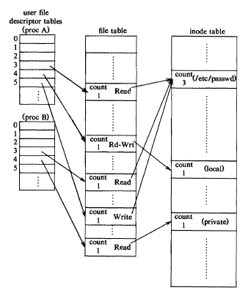

Slide 18
creat() system call
Syntax is
fd = creat(pathname,mode)
int creat(const char *path, mode_t mode);
modes-: permissions
flags : O_WRONLY|O_CREAT|O_TRUNC always same constant value, so no need to mention

Slide 19
Close ()
int close( int fd); /*file descriptor */
/* Returns 0 on success and -1 on error */
It makes the file descriptor available for re-use.
It does not flush any kernel buffers or perform any other clean-up task.
Decrements inode count

Slide 20
read() system call
size_t read(int fd, void *buf, size_t nbytes);
size_t write(int fd, void *buf, size_t nbytes);
fd – file descriptor
buf – buffer to hold data after read
nbytes – number of bytes to be read
Both functions return number of bytes read/written and returns -1 on error.

Slide 21
Write system call
#include<sys/types.h>
# include<unistd.h>
ssize_t write(
int fd, /* open file descriptor on which to write*/
const void *buf, /*data to write*/
ssize_t nbytes /*amount to write*/
);
/* Returns the number of bytes written or -1 on error */

Slide 22
int main()
{
char buffer[128];
int nread;
nread = read(0,buffer,128); // reading data from STD_INPUT fd =0
printf("nread = %d\n",nread);
if(nread == -1)
write(2,"A read Error has occurred\n",26); //writing error to STD_ERR fd = 2
if((write(1,buffer,nread)) != nread) //writing data to STD_OUTPUT fd = 1
write(2,"write error has occurred\n",25);
exit(0);
}
read & write system calls

Slide 23
lseek() system call
It sets the read/write pointer of a file descriptor which it can use for next read/write
off_t lseek(int fd, off_t offset, int reference);
offset is used to specify the position
reference is used by the offset
SEEK_SET – offset is absolute position
SEEK_CUR – offset is relative to the current position
SEEK_END – offset is relative to the end of the file

Slide 24
int main(int argc,char * argv[])
{
int fd1,sekval,nread;
char c,buf[20];
fd1 = open(argv[1],O_RDONLY);
if(fd1 == -1)
{
printf("Error opening file\n");
exit(0);
}
if((nread=read(fd1,&c,1))==1)
{
printf("%c\n",c);
sekval = lseek(fd1,10,SEEK_CUR);// next seek value = 11
}
read(fd1,&c,1);
printf("%c\n",c);
close(fd1); }
lseek()
[Mayuri@localhost myopen]$ ./a.out t1.txt
i
n
[Mayuri@localhost myopen]$

Slide 25
Lseek() file t1.txt
introduction to computing systems from bits and gates to C and beyond Birla institute of technology and science, pilani (rajasthan)

Slide 26
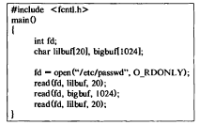

Slide 27
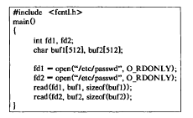

Slide 28
Thank You

